Slide 1

Permissions in Harmony

Slide 2
Today’s Session is about
Overview
Permissions in Android
Available Permissions
Adding permissions in config.json
Dynamically requesting permission

Slide 3
Overview
If an application needs to access data of the system or other applications or calls a system capability to implement specific functions such as making phone calls, the system and the related applications should provide the required interfaces. To ensure security, the application permission mechanism is then used to impose restrictions on these interfaces.
Application permission enable an application to access and perform designated operations on the designated object. At the application layer , permissions must be explicitly defined and user-authorized to standardized application behavior and permission authorization.

Slide 4
Permissions in Android
1

Slide 5
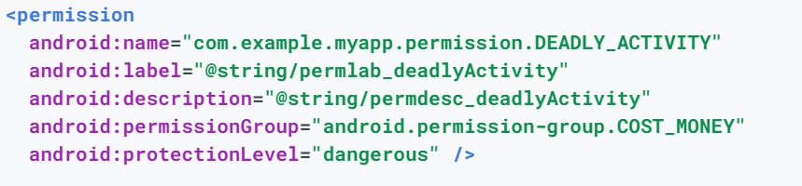
Permissions in Android
Specifies a system permission that the user must grant in oreder for the app to operate correctly in below format
<uses-permission android:name=“string”
android:maxSdkVersion=“Integer”/>
For declaring a new custom permission [Declares a security permission that can be used to limit access to specific components or features of this or other applications]
A list of permissions defined by the base can be found at android Manifest.permission

Slide 6
Available Permissions
Sensitive
* Involves sensitive data access, requires authorization from the user by following a dynamic permission request process
*Eg: LOCATION, CAMERA, MICROPHONE etc.
Non-Sensitive
*Permissions that do not involve sensitive user data or risky operations. You only need to declare them in the config.json file. The permissions are granted after your application is installed
*Eg:USE_BLUETOOTH, INTERNET, GET_WIFI_INFO etc.
Restricted
*Unavailable to third-party applications. If you need these permissions in some special scenarios, provide required materials to HUAWEI AppGallery to request the permission certificates
*Eg: READ_MESSAGES,READ_CONTACTS etc.

Slide 7
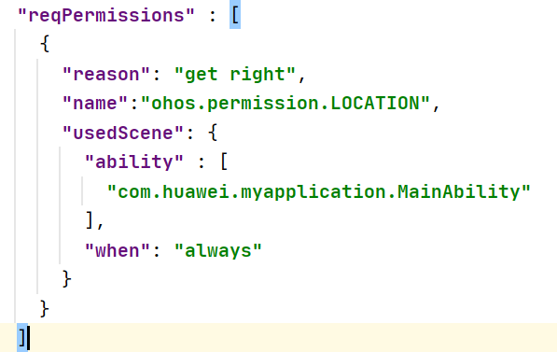
Adding permissions in config.json
Declare permissions in reqPermissions field in the config.json file as shown here :
Name*: permission name
Reason: reason for requesting permission
Used-scene: scene where the permission is used
When: can be inuse or always

Slide 8

Dynamically requesting permissions
Step 1: Declare the permission in config.json
A list of permissions defined by the base platform can be found at ohos.Security.SystemPermission

Slide 9
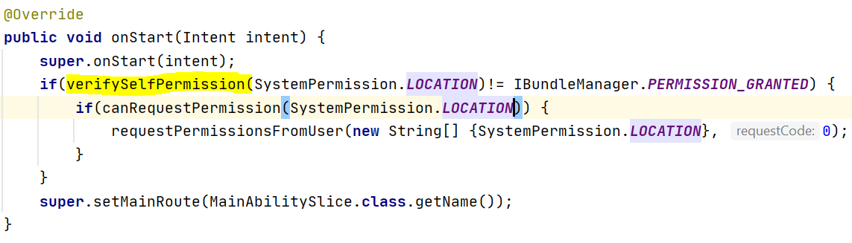
Dynamically requesting permissions(contd.)
Step 2: Check whether the permission has been granted to the application using ohos.app.Context.verifySelfPermission
Return value:
IBundleManager.PERMISSION_DENIED
IBundleManager.PERMISSION_GRANTED

Slide 10
canRequestPermission(String permission)
Confirms with the permission management module to check whether a request prompt is required for granting a certain permission
Returns true if the current application does not have the permission and the user does no turn off further requests.
Returns false if the current application has the permission, the permission is rejected by the system or the permission is denied by the user and the user has turned off further requests.

Slide 11
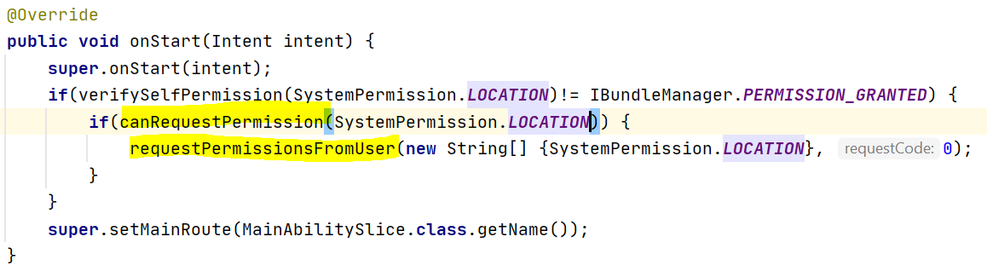
Dynamically Requesting permissions(contd.)
Step 3: If permission is not granted check if permission can be requested using canRequestPermission() then dynamically request the permission using requestPermissionFromUser (permissionString, Code)

Slide 12
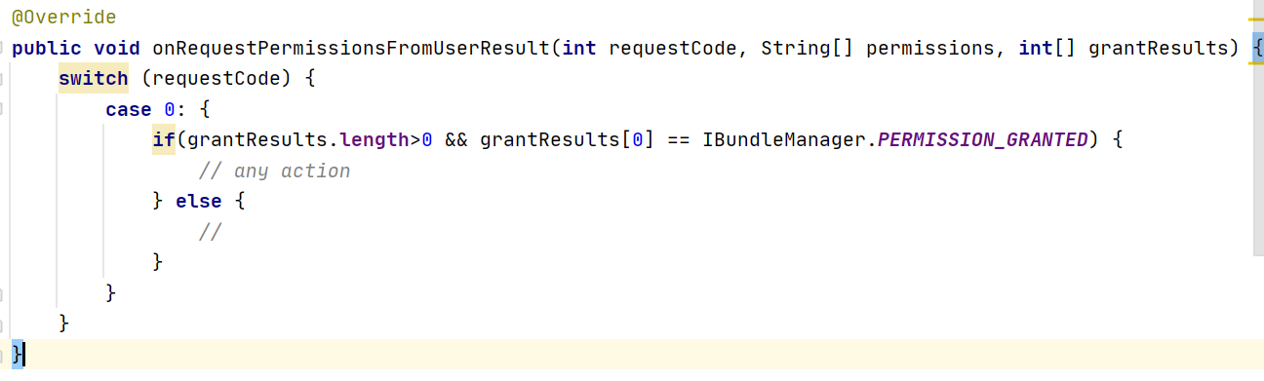
Dynamically Requesting permissions(contd.)
The authorization result is obtained in the below callback function onRequestPermissionsFromUserResult()

Slide 13
THANK YOU

